Slide 1
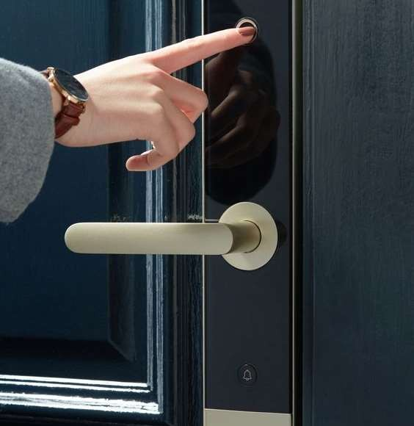
ARDUINO RFID SOLENOID LOCK
PROJECT PRESENTED BY SIVA ROOBAN(210701251) SHRIRAM(210701248

Slide 2

INTRODUCTION
The Arduino RFID solenoid lock combines RFID technology with a solenoid lock, controlled by an Arduino microcontroller. Users authenticate via RFID tags/cards, triggering the solenoid to lock or unlock. The Arduino manages the system, verifying user credentials and controlling access. This setup offers a customizable and cost- effective solution for securing environments like homes or offices. It enhances security by restricting access to authorized individuals while allowing for easy management and logging of access attempts. Ideal for DIY projects, its simplicity and versatility make it a popular choice for various security applications.
ANITA RAJPUT
PAGE 02

Slide 3

PURPOSE OF OUR PROJECT
The purpose of our Arduino RFID solenoid lock project is to create a secure access control system utilizing RFID technology and a solenoid lock, managed by an Arduino microcontroller. This project aims to provide convenient, reliable, and customizable access control for various environments, enhancing security and convenience for users.
FLEXBILITY
CONVIENCE
SECURITY
PAGE 03

Slide 4

PURPOSE
The result of an Arduino RFID solenoid lock project typically involves the successful implementation of a secure access control system
1
1 . SECURITY
Offering a user-friendly solution for accessing secured areas without the need for traditional keys, streamlining entry for authorized users.
2
2.COVIENCE
The result of an Arduino RFID solenoid lock project typically involves the successful implementation of a secure access control system
3
3. FLEXBILITY

Slide 5
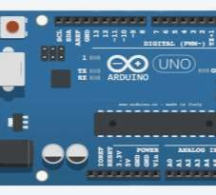
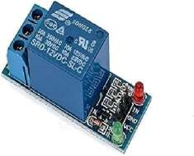
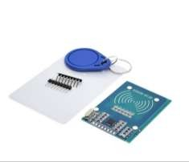
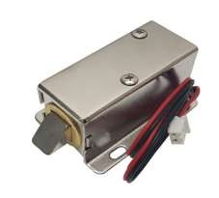
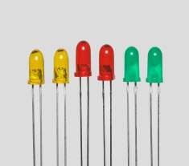
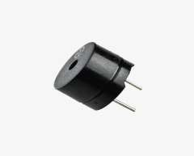
COMPONENTS
. ARDUINO UNO
.RELAY MODULE
ARDUINO UNO
RELAY MODULE
RFID SENSOR
.RFID SENSOR
.SOLENOID LOCK
.LED
.BUZZER
.BREADBOARD
SOLENOID LOCK
LED
BUZZER
.JUMPERS
PAGE 05

Slide 6
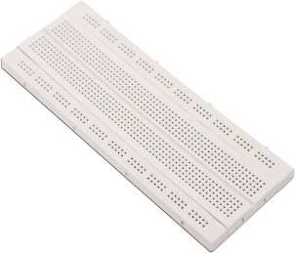
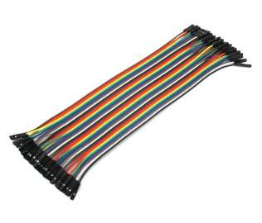
COMPONENTS
BREADBOARD
JUMPERWIRES
ANITA RAJPUT
PAGE 06

Slide 7
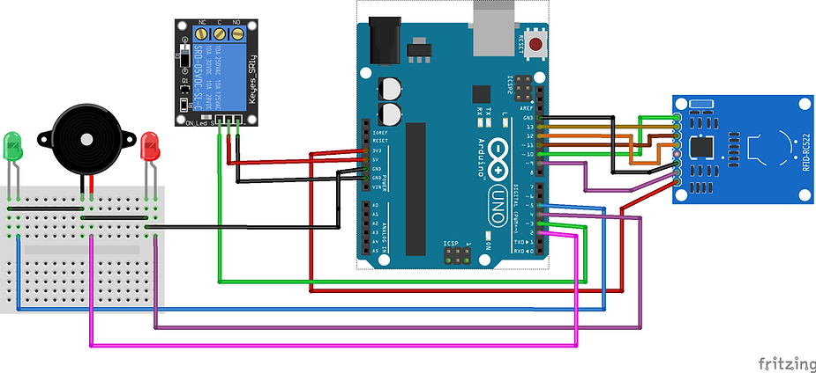
CIRCUIT
DIAGRAM
PAGE 07

Slide 8

RESULT
The result of an Arduino RFID solenoid lock project typically involves the successful
implementation of a secure access control system
Enhanced Security: The system effectively restricts access to authorized individuals only,
preventing unauthorized entry and enhancing overall security.
Convenient Access: Users can easily unlock doors or mechanisms using RFID tags/cards,
eliminating the need for traditional keys and providing a more convenient access solution.
Customization and Scalability: The Arduino platform allows for easy customization and expansion of the system to suit specific needs and environments, making it versatile and adaptable.
PAGE 08

Slide 9
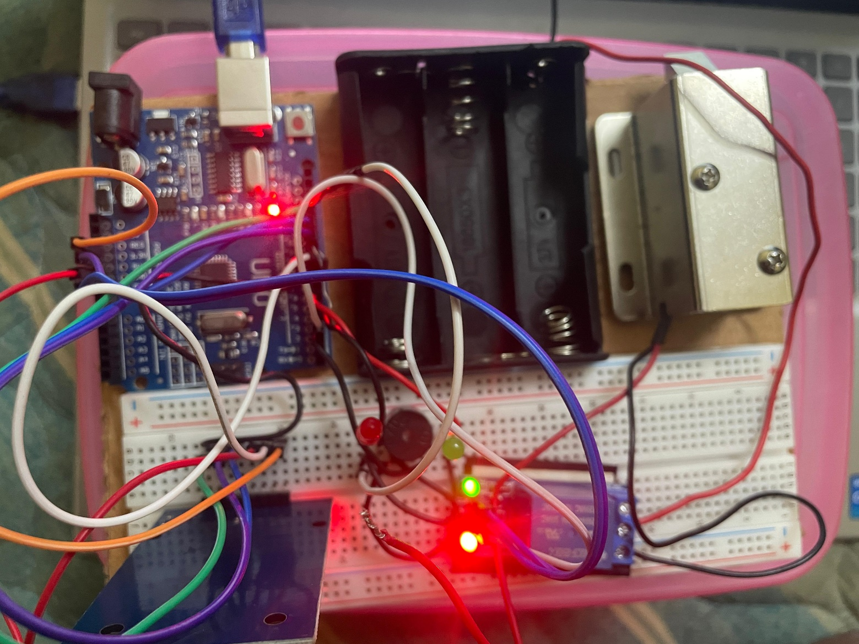
OUTPUT
PAGE 08

Slide 10

C O N C L U S I O N
The Arduino RFID solenoid lock project concludes with a robust security solution that effectively restricts access to authorized individuals, enhancing overall safety. By seamlessly integrating RFID technology with a solenoid lock and Arduino microcontroller, the project simplifies access control, eliminating the need for conventional keys. Its versatility allows for customization to suit diverse environments and requirements, ensuring scalability for future expansions. With streamlined access processes and advanced security features, this project offers a reliable and user-friendly solution for various applications, from residential to commercial settings, promising enhanced security and convenience for users while minimizing the risk of unauthorized access.

Slide 11

FUTURE SCOPES

Slide 12

FUTURE SCOPE
Future advancements in Arduino RFID solenoid lock systems could involve integrating machine learning algorithms to enhance security by recognizing and adapting to patterns of authorized user behavior. Additionally, incorporating blockchain technology could provide a decentralized and tamper-resistant method for managing access permissions and logging access attempts. Furthermore, the integration of energy harvesting techniques could enable self-powered operation, reducing reliance on external power sources and enhancing sustainability. Lastly, the adoption of ultra- wideband (UWB) technology could offer precise indoor positioning capabilities, enabling more granular access control and tracking of users within a facility. These innovations promise to further improve the effectiveness, efficiency, and versatility of RFID solenoid lock systems.

Slide 13


THANKS FOR THE OPPORTUNITY

